Slide 1
Does the IS Discipline require Regime Change?
Séamas Kelly

Slide 2
IS Discipline as a ‘Regime of Truth’ (Introna 2003)
Regime of Truth (Foucault 1977) – the institutional infrastructure/practices for the production and circulation of the truth claims (knowledge) of a discourse
Knowledge is political – all knowledge claims appeal to specific regimes of truth
As IS researchers we subject ourselves to the disciplinary practices of the regime of truth that constitutes our discipline
The status of IS as a discipline should be seen as a political question, rather than an onto-epistemological one
=> The continued existence of the IS discipline should not be taken as an indication of its inherently positive contribution to the world

Slide 3
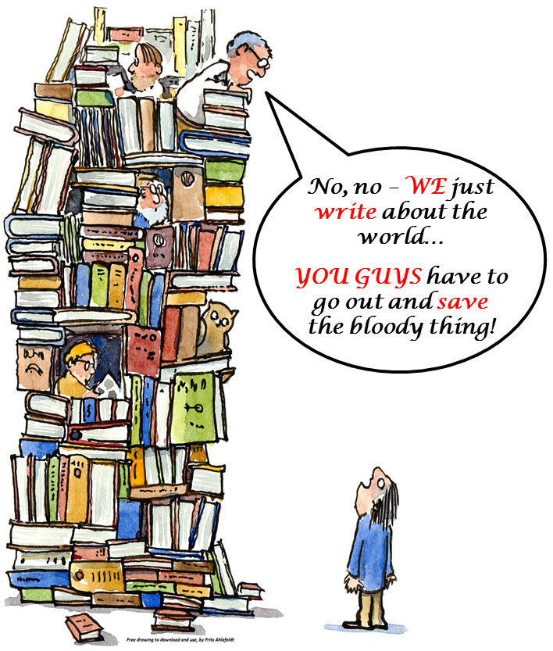
The Critique of Mainstream Business Research/Education
Relevance?
Engagement?
Criticality?
Innovation?

Slide 4
The Future of IS Research? (Walsham 2012)
 | Mainstream orientation
Unifying vision for IS field | Helping organisations use ICT effectively
Settings | Business & government
Overarching objectives | Improved effectiveness
Methodological approach | Dominance of Positivism
Relationship with other disciplines | Drawing on other disciplines
 | Traditional | Future
Unifying vision for IS field | Helping organisations use ICT effectively | Are we making a better world with ICT?
Settings | Business & government | Broader range of settings
Overarching objectives | Improved effectiveness | More critical and ethical orientation
Methodological approach | Dominance of Positivism | More eclectic
Relationship with other disciplines | Drawing from other disciplines | Genuine interdisciplinarity

Slide 5
A New Manifesto for IS Researchers?
We are human scientists concerned with understanding and shaping the role of ICT in processes of social/economic (re-)organisation, and the production of personhood, who are driven by an overarching concern with making a better world with ICT.
Critical engagement
Reframing problems through Conversations that Matter
Personal mastery – the craft of phronetic social inquiry

Slide 6
Difficulties of Regime Change?!

